Slide 1


Automatic Solar Lighting System Atahan Bakanyildiz, Romi Gilat, Cedar Maxwell, Nick Miller

Slide 2
What is the Automatic Solar Lighting System?
Problem: With increasing grid demand and reliability issues, integrating solar energy into homes is vital. Solar power offers a dependable, independent energy source, ensuring power during outages, reducing costs, and boosting sustainability.
Solution: By integrating solar panels into homes, individuals can have peace of mind knowing they will have reliable power for up to a week during emergencies. This system will provide lighting, activated by motion, for the foyer and patio, and can be controlled remotely via an app for convenient access.
Notes:
transition: “So, what does this system look like?”

Slide 3
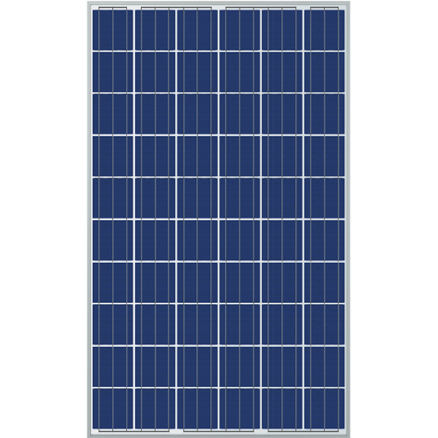




System Visual
PIR/Ambient Sensor
PIR Sensor
MCU
Cloud Database
App
Buck Converter and Inverter
Charge Controller and 12V Battery
Patio
Foyer

Slide 4
System Interface
Microcontroller Unit
Charge Controller
Inside Sensor
Outside Sensor
Solar Panel
Controllers and Sensors
Cloud Database
Control
12V Battery
Power Generation
App
Buck Converter
Converter/Inverter
Power
Data
Load & Inversion
Nick: Load & Inversion Atahan: Power Generation
Romi: MCU & Sensor Cedar: App & Database

Slide 5
Inverter and Buck converter
Team Member: Nick Miller
Accomplishments since the last presentation 32 Hours | Ongoing progress/problems and plans until the next presentation
PCB ordered. PCB assembled. Began PCB debugging. | Continue PCB debugging. Final Demo: Monitor output voltage of Buck Converter while subjecting it to varying input voltages and currents. Varying light bulbs to demonstrate Inverter handling different loads.

Slide 6
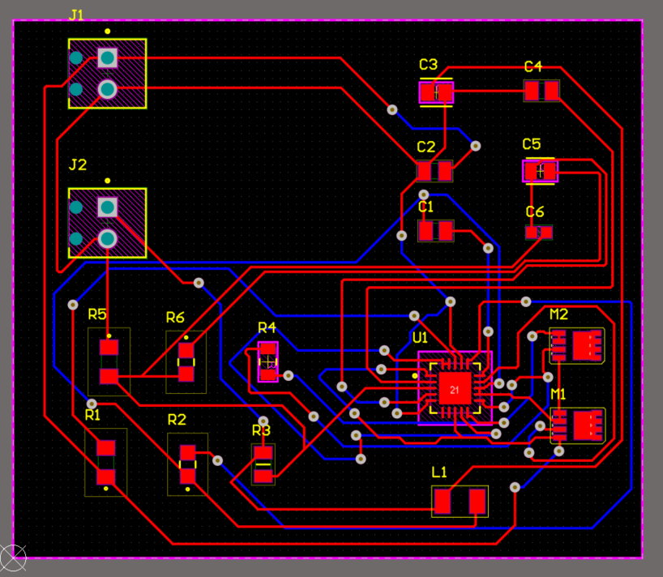
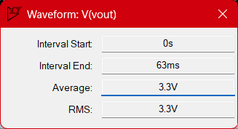
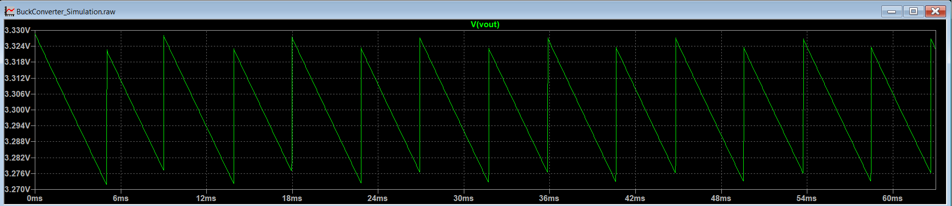
Buck Converter in Theory

Slide 7
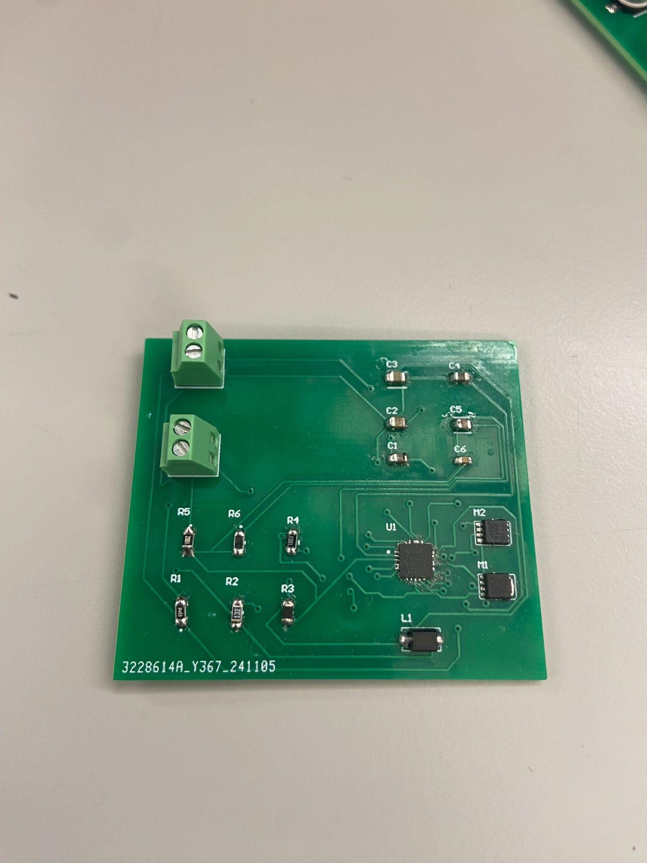
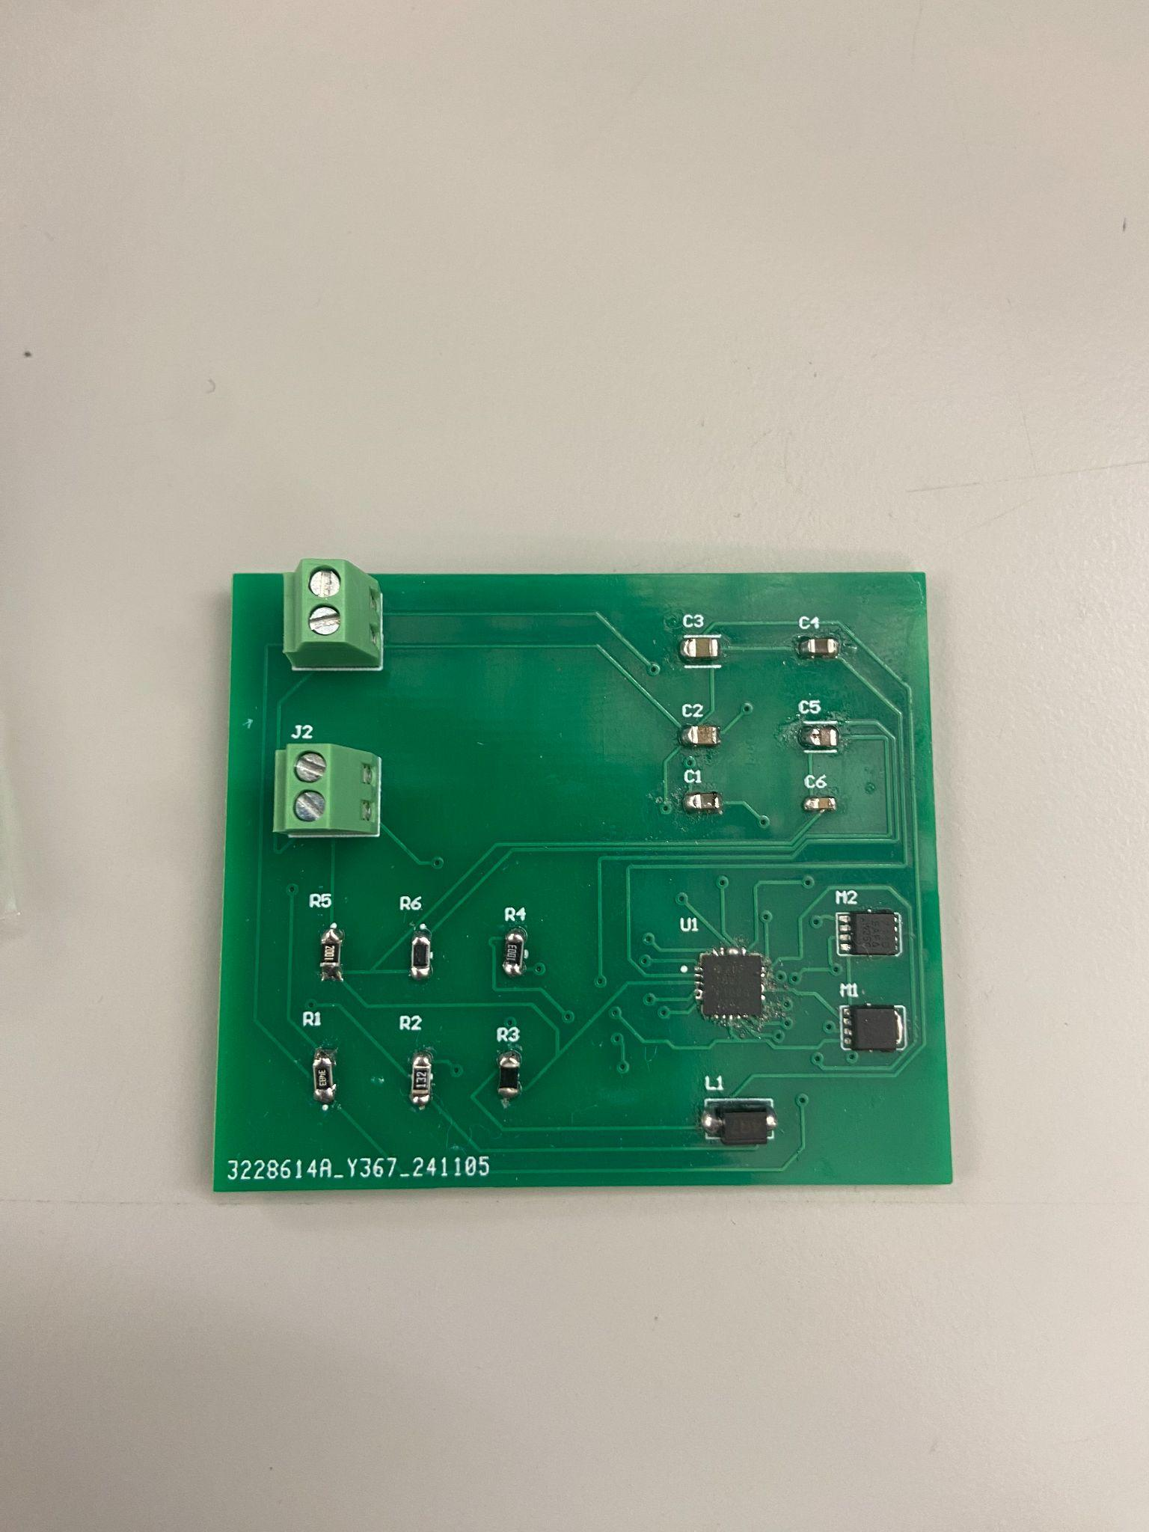
Buck Converter Assembled

Slide 8
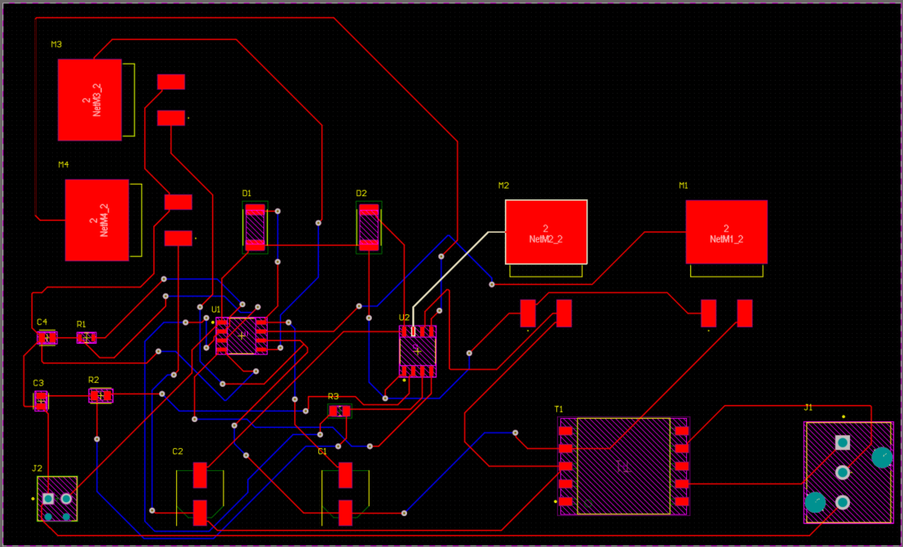
Inverter PCB Design

Slide 9
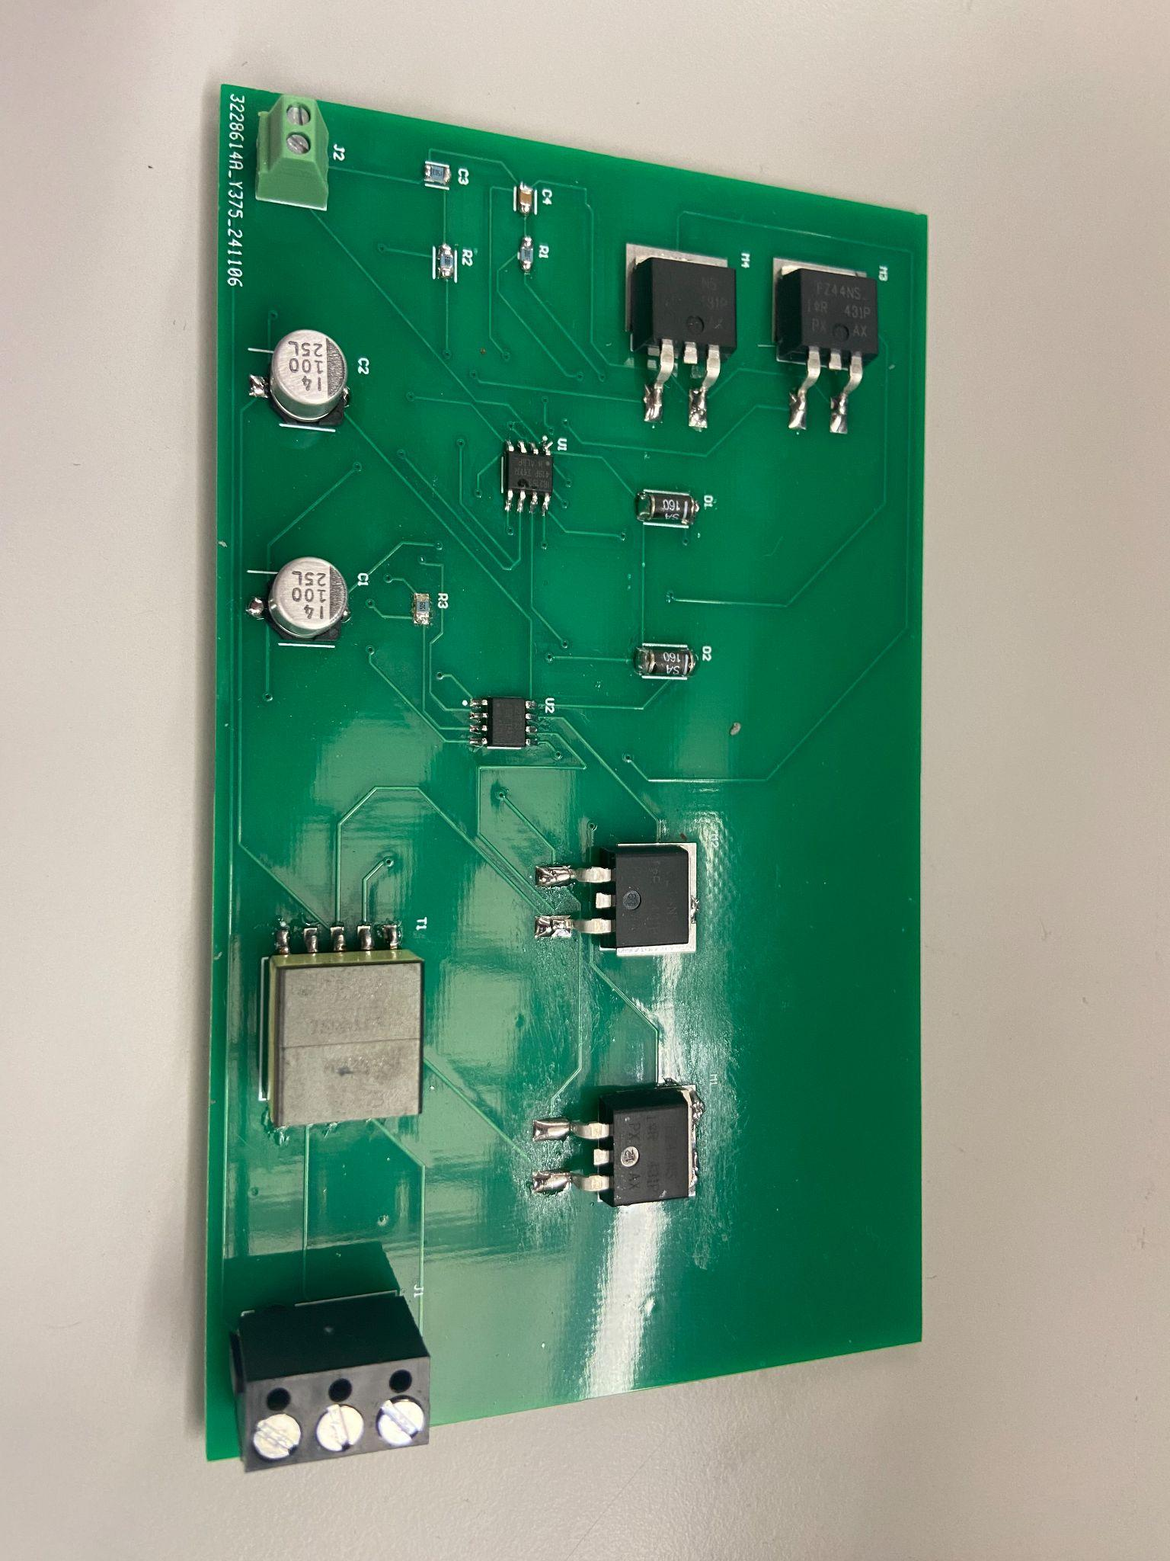
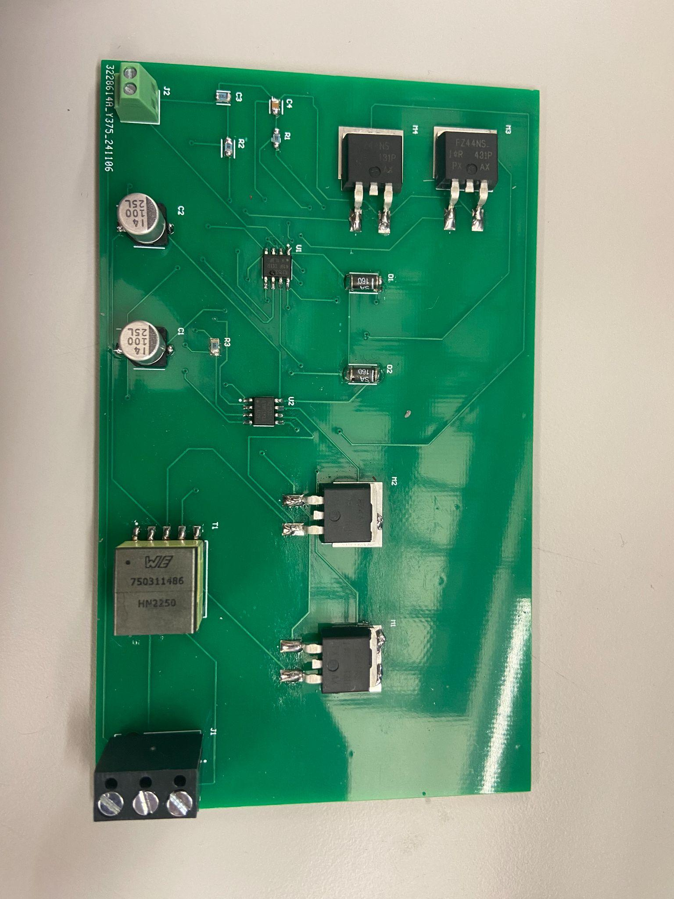
Inverter Assembled

Slide 10
Remaining Tasks
Validate and test Buck Converter and Inverter.
Debug PCB boards.
Adjust Trace Width.
Key tasks for 404
Integrate and power other subsystems.
Connect to MCU, Sensors, Lightbulbs.
Allow trigger from MCU to turn on/off lights.

Slide 11
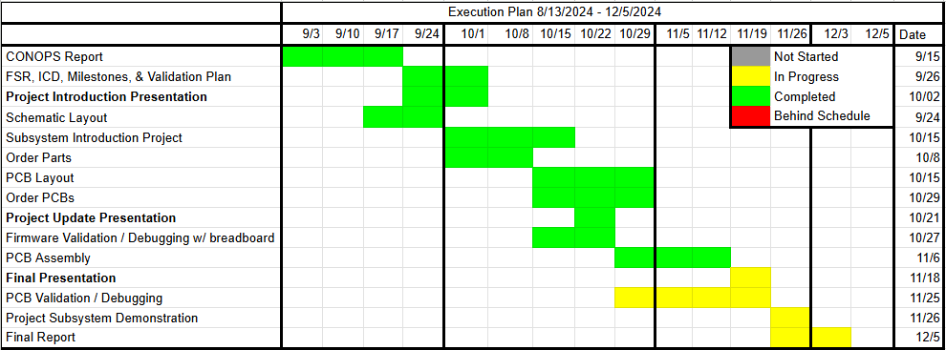
Subsystem Progress

Slide 12
Microcontroller and Sensor system
Team member: Romi Gilat
Accomplishments since the last presentation <45> hours | Ongoing progress Plans for final demo
PCB ordered PCB assembled Coded portion of MCU | Finish coding PIC24 for exterior and interior sensors Final demo: halogen bulbs and filters to test sensors Connect MCU & Sensors

Slide 13
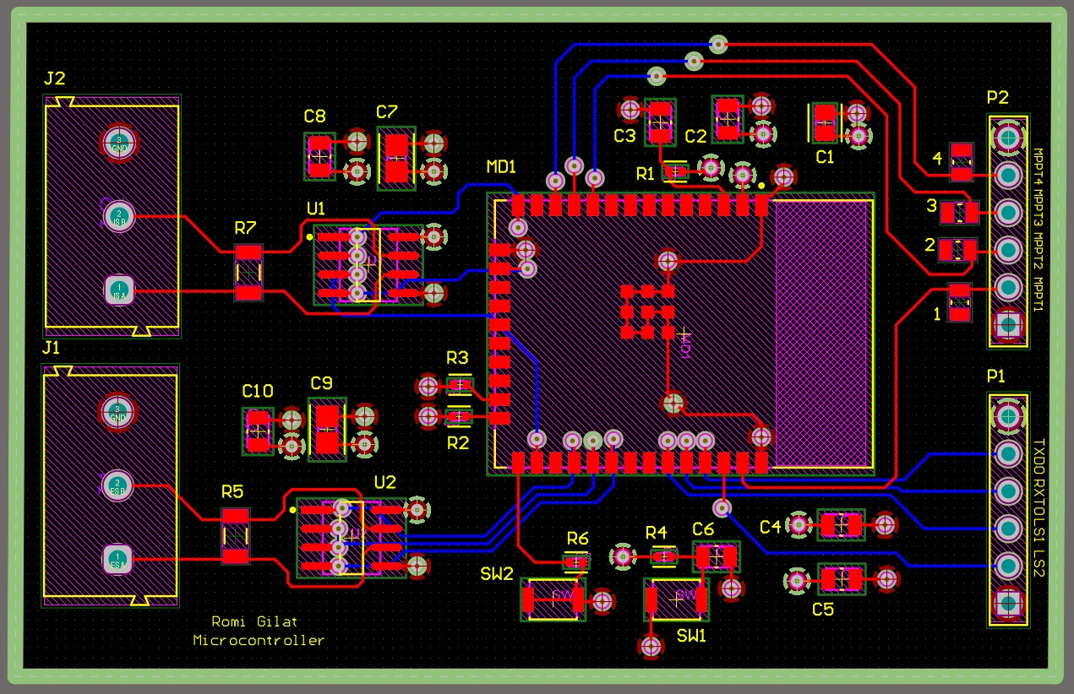
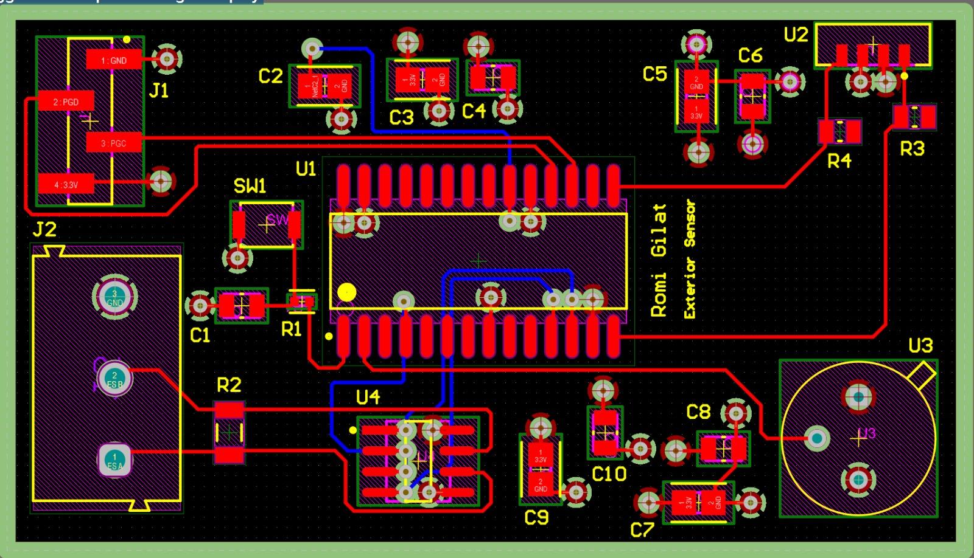
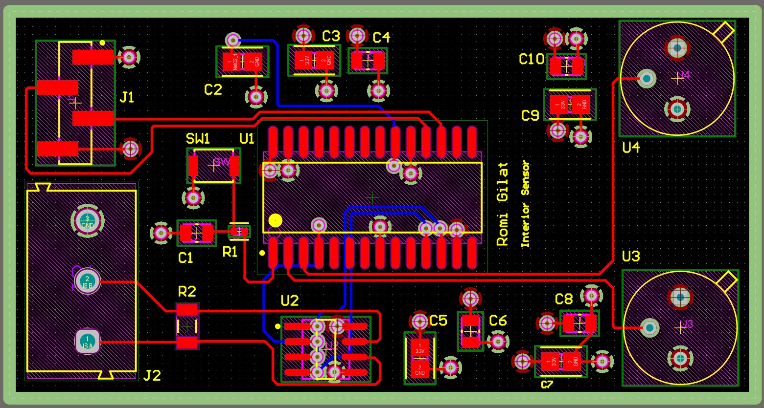
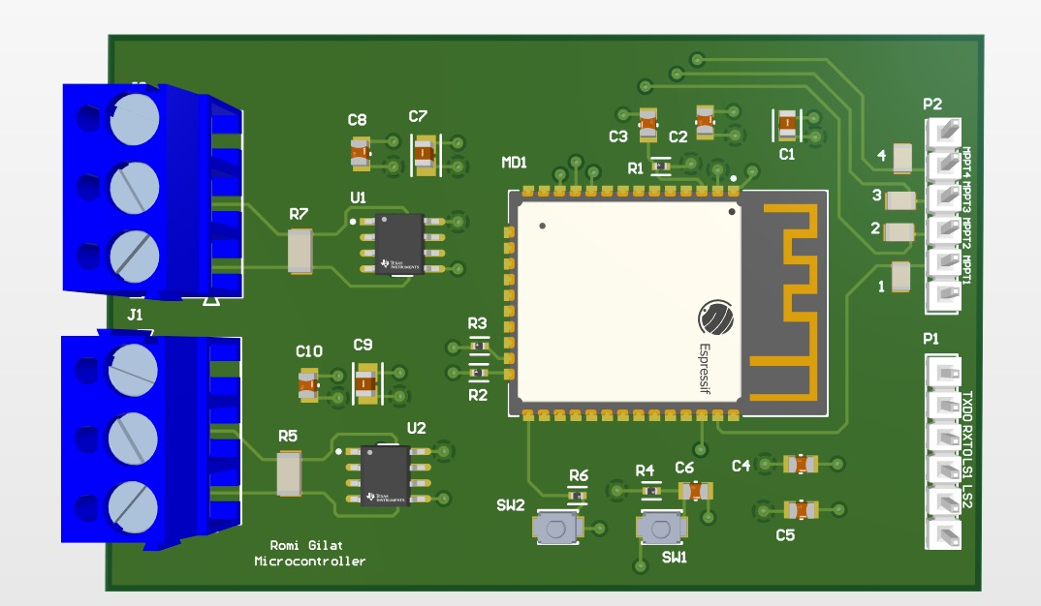
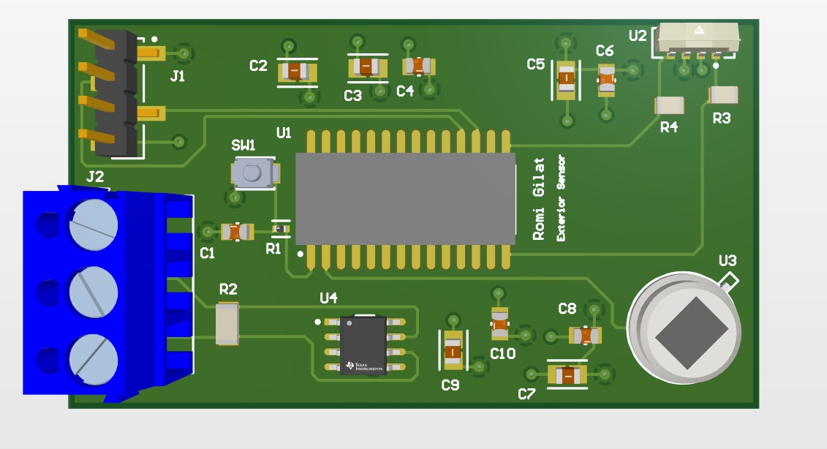
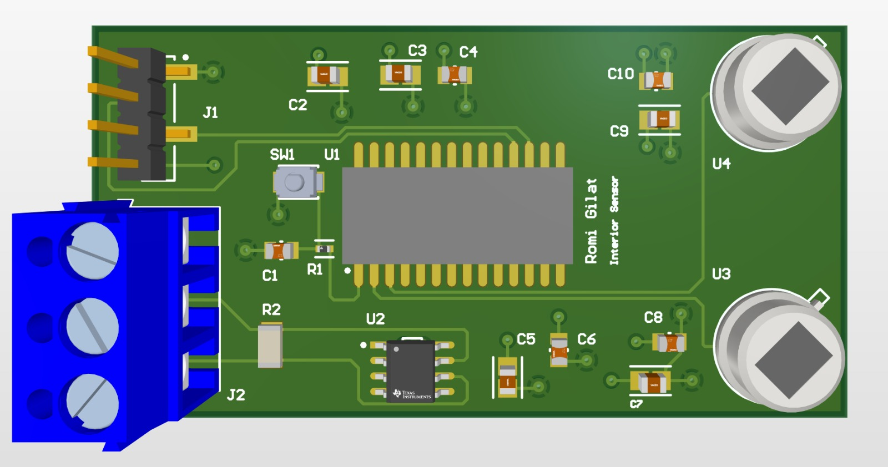
Microcontroller & Sensors PCB

Slide 14
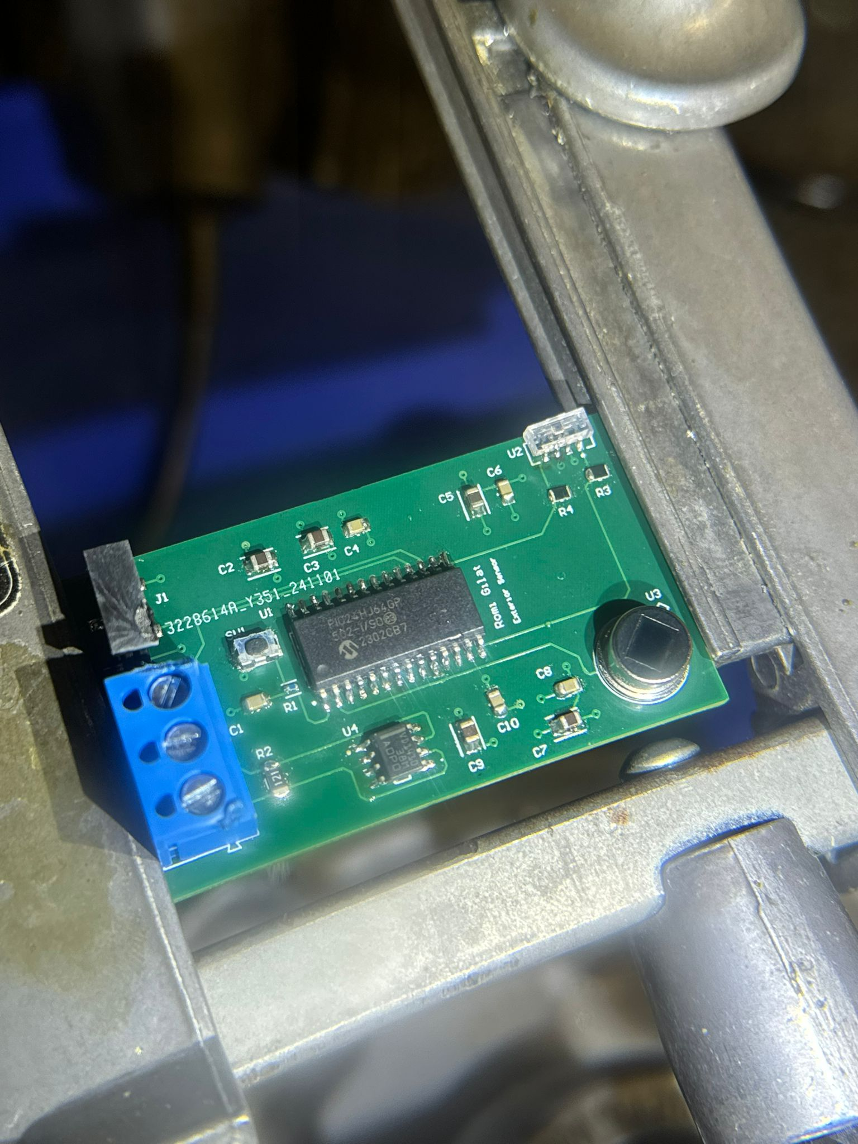
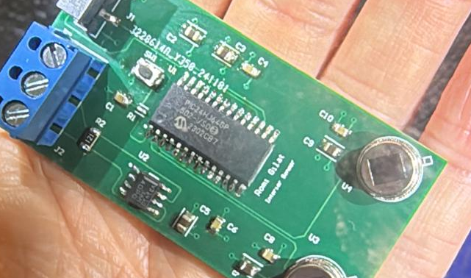
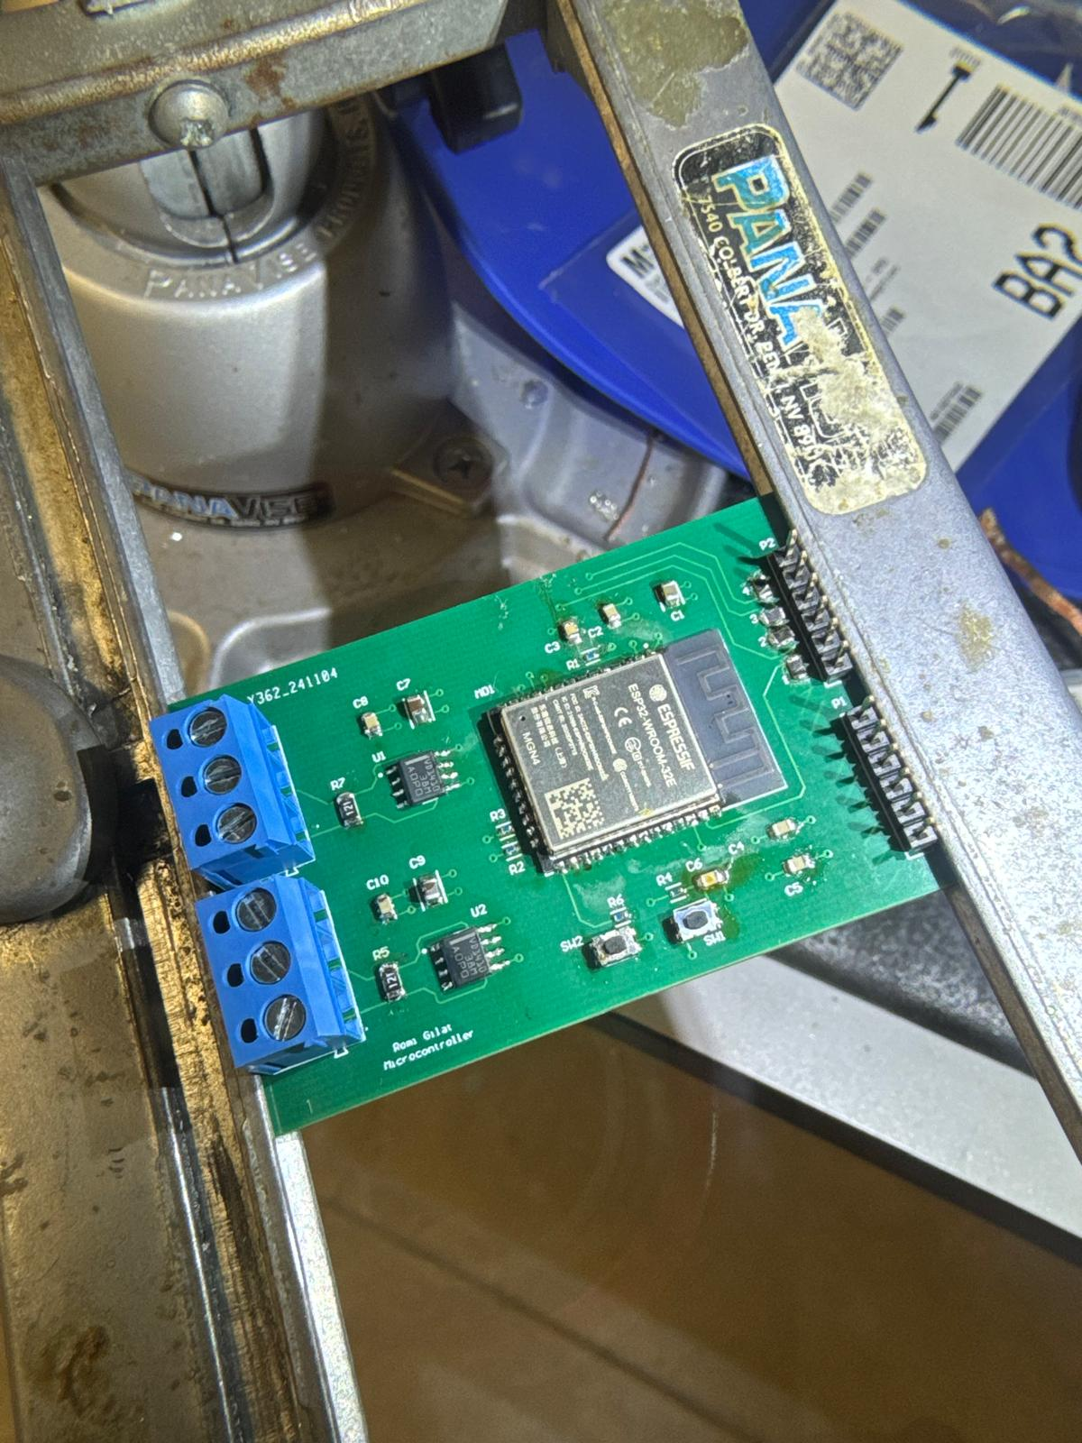
Microcontroller, Interior and Exterior Sensor Assembly
Notes:
romi

Slide 15
Microcontroller code
#include <stdio.h>
#include "driver/gpio.h"
#include "driver/uart.h"
#include "esp_log.h"
#include "freertos/FreeRTOS.h"
#include "freertos/task.h"
#include <string.h>
#include <stdlib.h>
#include "esp_system.h"
#include "nvs_flash.h"
#include "freertos/queue.h"
#include "sdkconfig.h"
#define TAG "RS485_ECHO_APP"
// UART and GPIO Pin Definitions
#define EXTERIOR_TXD1_PIN (GPIO_NUM_16) // UART TX1 for exterior
#define EXTERIOR_RXD1_PIN (GPIO_NUM_14) // UART RX1 for exterior
#define INTERIOR_TXD2_PIN (GPIO_NUM_30) // UART TX2 for interior
#define INTERIOR_RXD2_PIN (GPIO_NUM_28) // UART RX2 for interior
#define EXTERIOR_ENABLE_PIN (GPIO_NUM_26) // IO4 for THVD1 (exterior)
#define INTERIOR_ENABLE_PIN (GPIO_NUM_29) // IO5 for THVD2 (interior)
#define LIGHT_SIGNAL_1 (GPIO_NUM_33) // Exterior light signal pin
#define LIGHT_SIGNAL_2 (GPIO_NUM_36) // Interior light signal pin
#define UART_PORT_NUM_0 UART_NUM_0 // Use UART0 for default UART communication
#define UART_PORT_NUM_1 UART_NUM_1 // Use UART1 for RS485 communication
#define UART_BAUD_RATE 9600
#define BUF_SIZE (1024)
// Function to configure GPIO pins
void configure_gpio() {
gpio_reset_pin(EXTERIOR_ENABLE_PIN);
gpio_set_direction(EXTERIOR_ENABLE_PIN, GPIO_MODE_OUTPUT);
gpio_set_level(EXTERIOR_ENABLE_PIN, 0);
gpio_reset_pin(INTERIOR_ENABLE_PIN);
gpio_set_direction(INTERIOR_ENABLE_PIN, GPIO_MODE_OUTPUT);
gpio_set_level(INTERIOR_ENABLE_PIN, 0);
gpio_reset_pin(LIGHT_SIGNAL_1);
gpio_set_direction(LIGHT_SIGNAL_1, GPIO_MODE_OUTPUT);
gpio_set_level(LIGHT_SIGNAL_1, 0);
gpio_reset_pin(LIGHT_SIGNAL_2);
gpio_set_direction(LIGHT_SIGNAL_2, GPIO_MODE_OUTPUT);
gpio_set_level(LIGHT_SIGNAL_2, 0);
}
// Function to initialize UART for both sensors
void uart_init() {
const uart_config_t uart_config = {
.baud_rate = UART_BAUD_RATE,
.data_bits = UART_DATA_8_BITS,
.parity = UART_PARITY_DISABLE,
.stop_bits = UART_STOP_BITS_1,
.flow_ctrl = UART_HW_FLOWCTRL_DISABLE,
};
// Initialize UART0 for exterior sensor communication
uart_param_config(UART_PORT_NUM_0, &uart_config);
uart_set_pin(UART_PORT_NUM_0, EXTERIOR_TXD1_PIN, EXTERIOR_RXD1_PIN, UART_PIN_NO_CHANGE, UART_PIN_NO_CHANGE);
uart_driver_install(UART_PORT_NUM_0, BUF_SIZE * 2, 0, 0, NULL, 0);
// Initialize UART1 for interior sensor communication
uart_param_config(UART_PORT_NUM_1, &uart_config);
uart_set_pin(UART_PORT_NUM_1, INTERIOR_TXD2_PIN, INTERIOR_RXD2_PIN, UART_PIN_NO_CHANGE, UART_PIN_NO_CHANGE);
uart_driver_install(UART_PORT_NUM_1, BUF_SIZE * 2, 0, 0, NULL, 0);
// Set both UARTs to RS485 half-duplex mode
uart_set_mode(UART_PORT_NUM_0, UART_MODE_RS485_HALF_DUPLEX);
uart_set_mode(UART_PORT_NUM_1, UART_MODE_RS485_HALF_DUPLEX);
}
// Task to handle UART communication and light control for the exterior sensor
void exterior_sensor_task(void *arg) {
uint8_t data[BUF_SIZE];
while (1) {
int len = uart_read_bytes(UART_PORT_NUM_0, data, BUF_SIZE, 20 / portTICK_PERIOD_MS);
if (len > 0) {
ESP_LOGI(TAG, "Exterior sensor triggered, turning on light signal 1");
gpio_set_level(LIGHT_SIGNAL_1, 1);
vTaskDelay(pdMS_TO_TICKS(600000)); // 10 minutes
gpio_set_level(LIGHT_SIGNAL_1, 0);
}
vTaskDelay(pdMS_TO_TICKS(100));
}
}
// Task to handle UART communication and light control for the interior sensor
void interior_sensor_task(void *arg) {
uint8_t data[BUF_SIZE];
while (1) {
int len = uart_read_bytes(UART_PORT_NUM_1, data, BUF_SIZE, 20 / portTICK_PERIOD_MS);
if (len > 0) {
ESP_LOGI(TAG, "Interior sensor triggered, turning on light signal 2");
gpio_set_level(LIGHT_SIGNAL_2, 1);
vTaskDelay(pdMS_TO_TICKS(600000)); // 10 minutes
gpio_set_level(LIGHT_SIGNAL_2, 0);
}
vTaskDelay(pdMS_TO_TICKS(100));
}
}
void app_main() {
ESP_LOGI(TAG, "Configuring GPIO pins...");
configure_gpio();
ESP_LOGI(TAG, "Initializing UART...");
uart_init();
ESP_LOGI(TAG, "Starting exterior and interior sensor tasks...");
xTaskCreate(exterior_sensor_task, "exterior_sensor_task", 2048, NULL, 10, NULL);
xTaskCreate(interior_sensor_task, "interior_sensor_task", 2048, NULL, 10, NULL);
}
GPIO configuration
Interior Sensor UART configuration
Exterior Sensor UART configuration

Slide 16
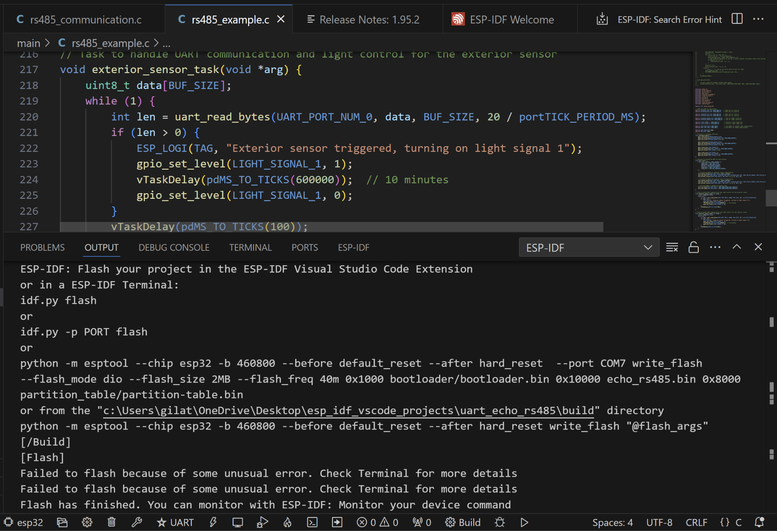
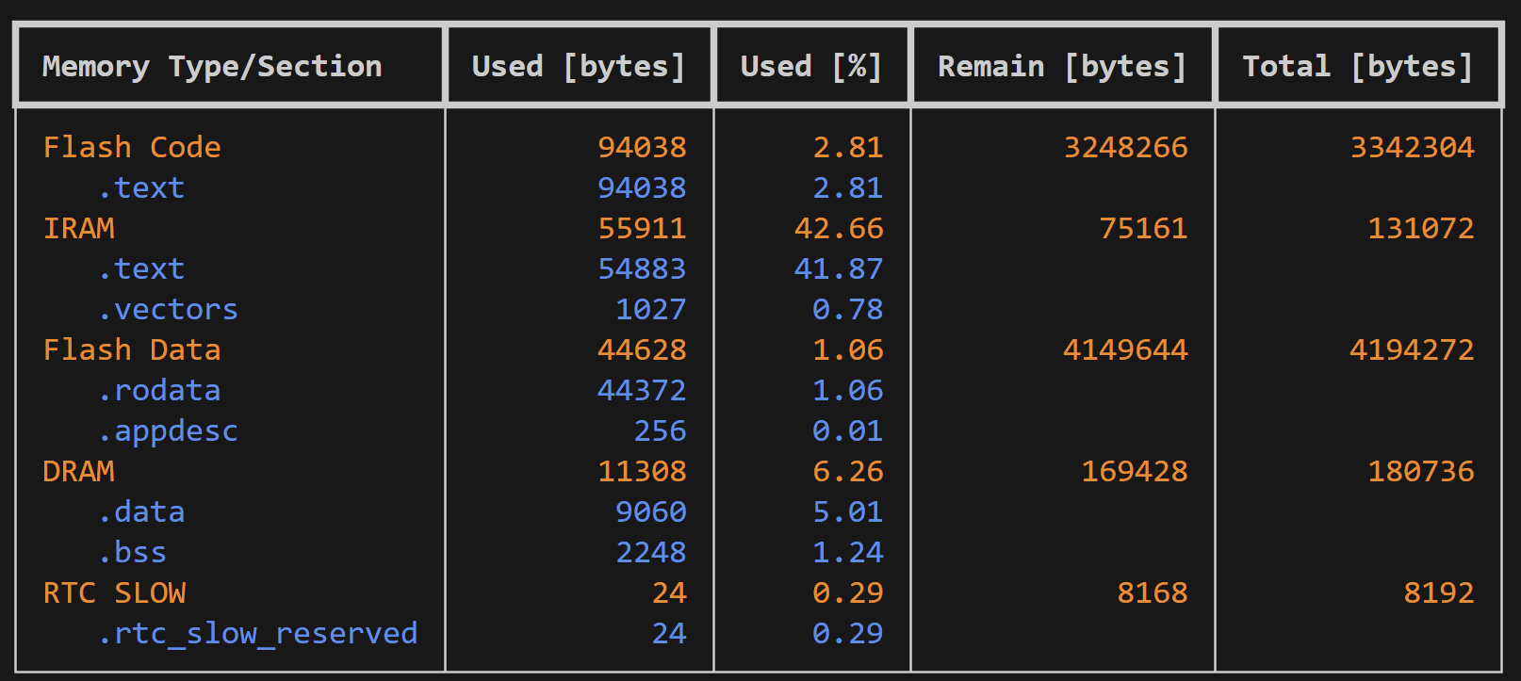
VS Code confirmation

Slide 17
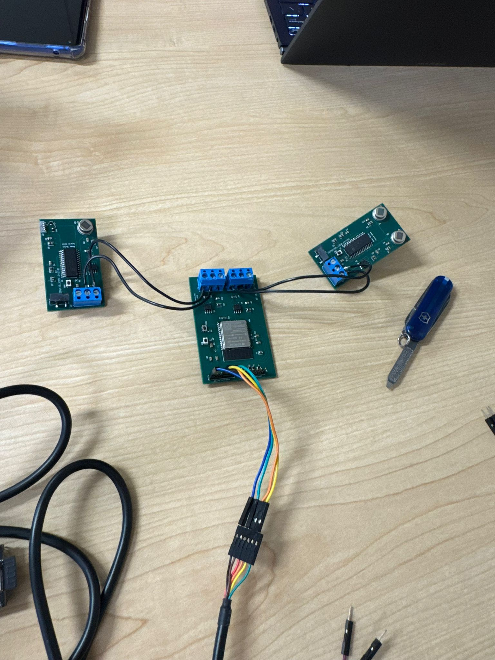
Final Setup
Interior Sensor
Exterior Sensor
Microcontroller

Slide 18
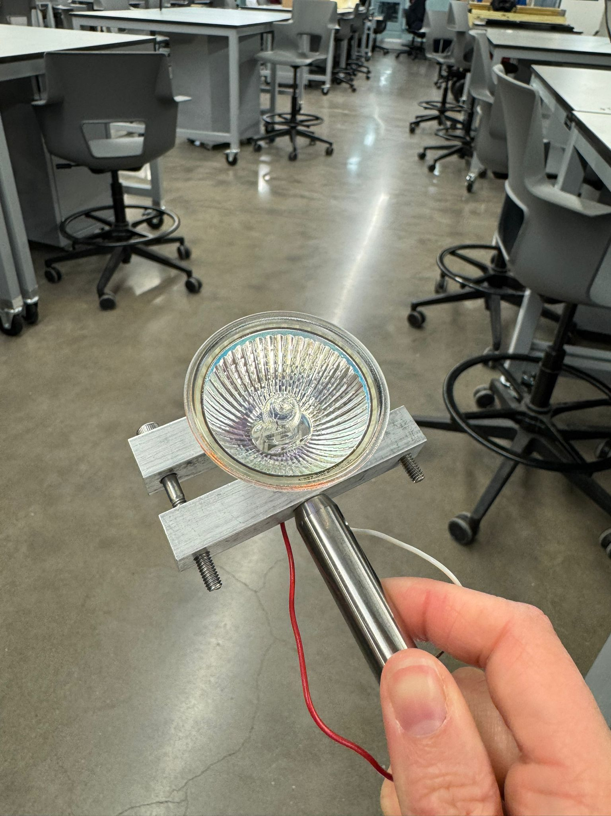
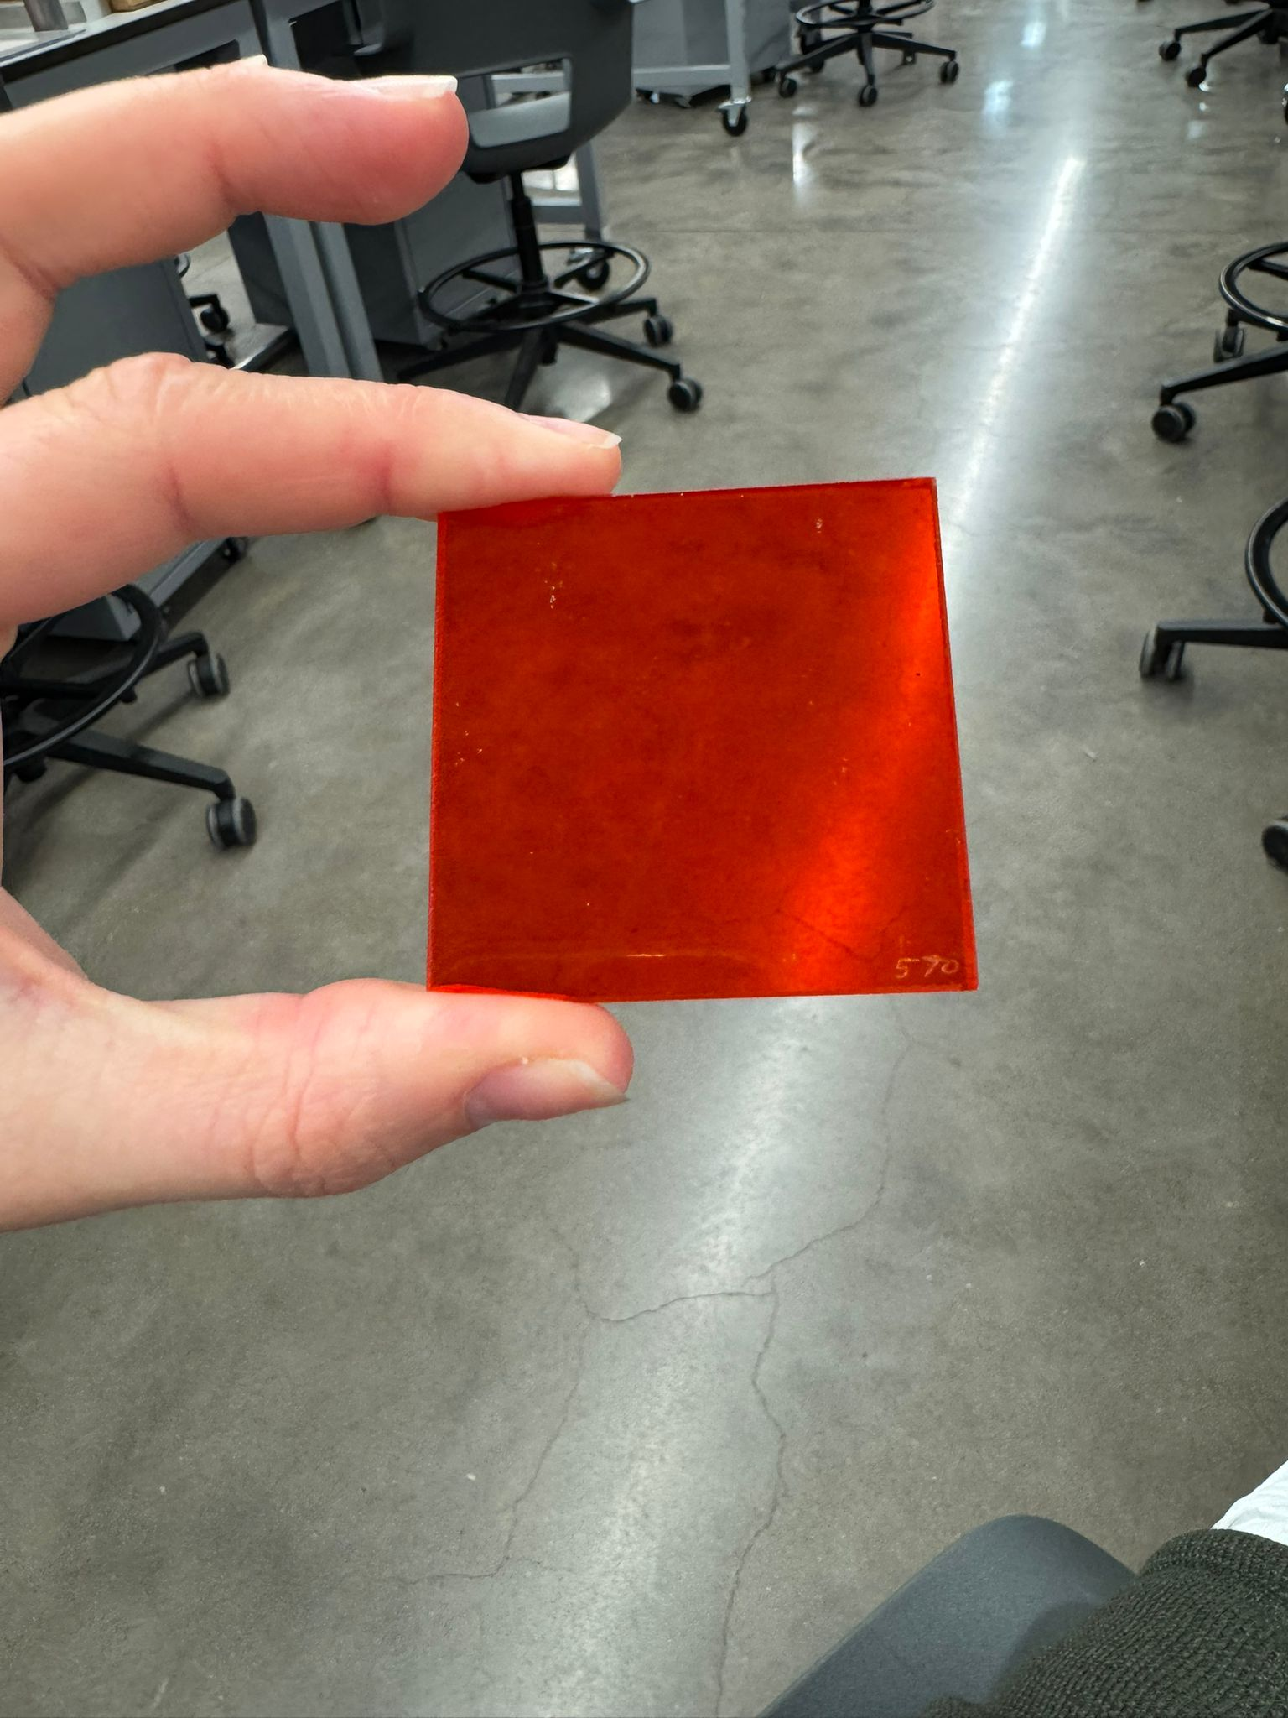
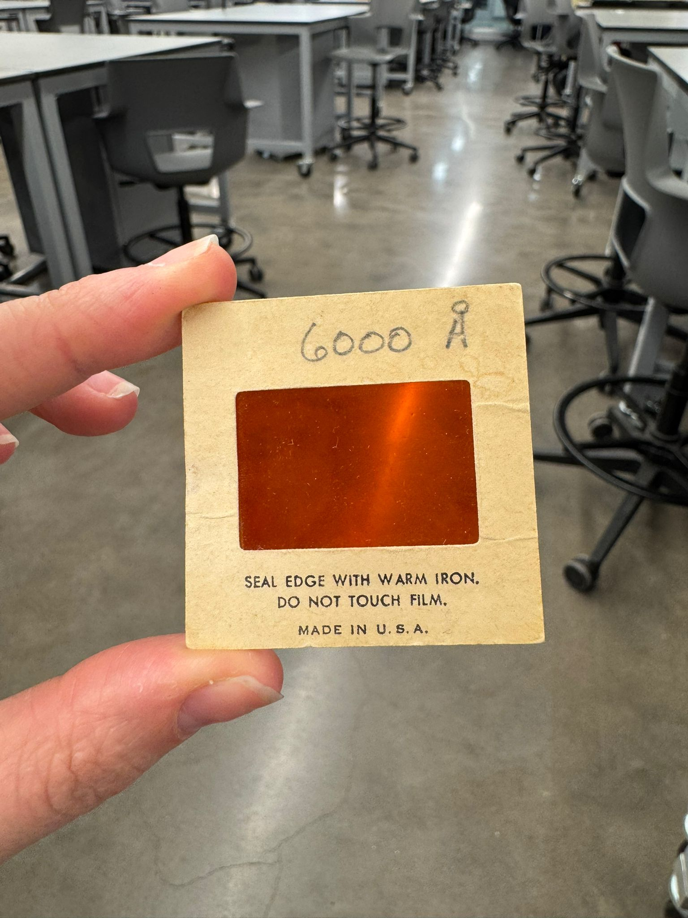
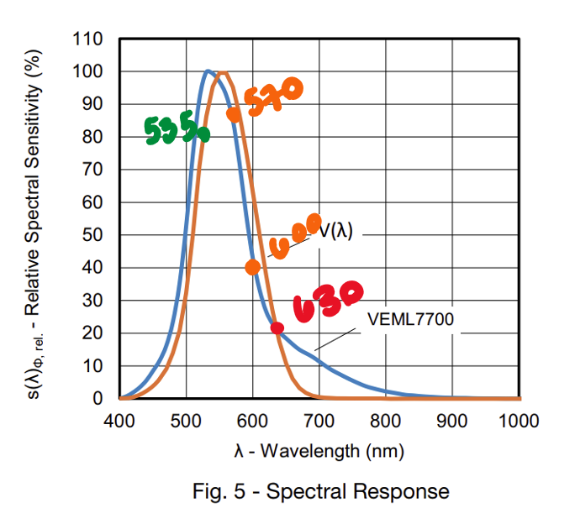
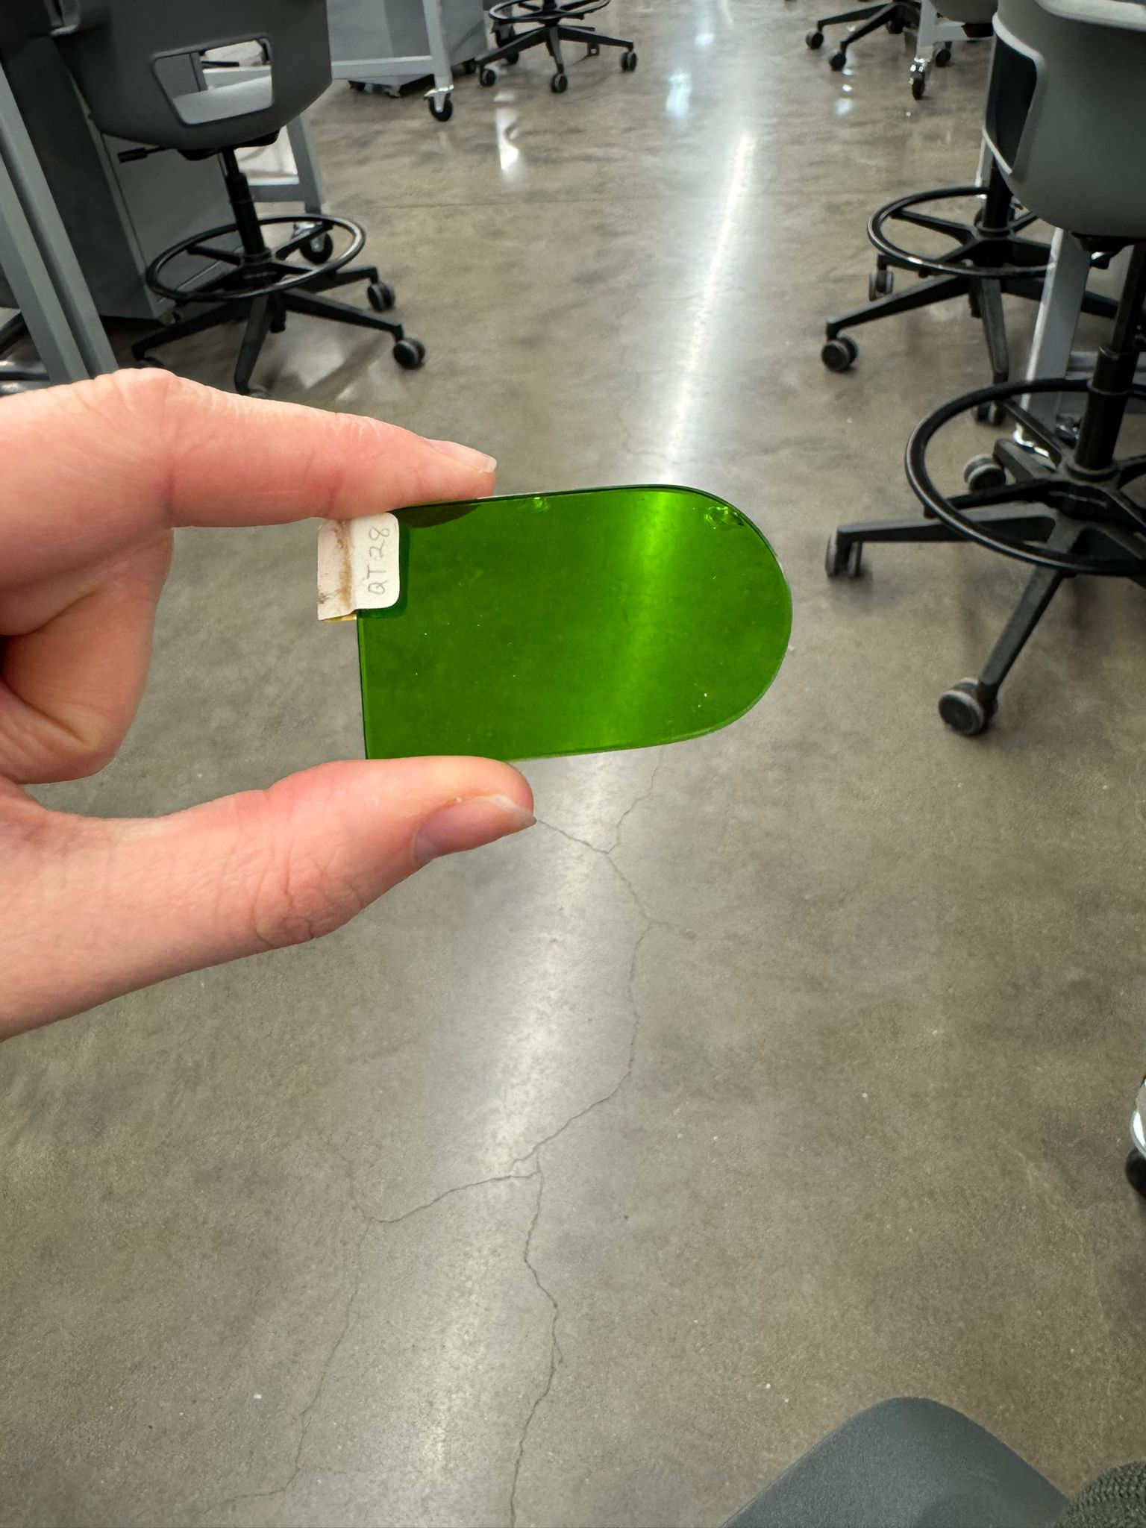
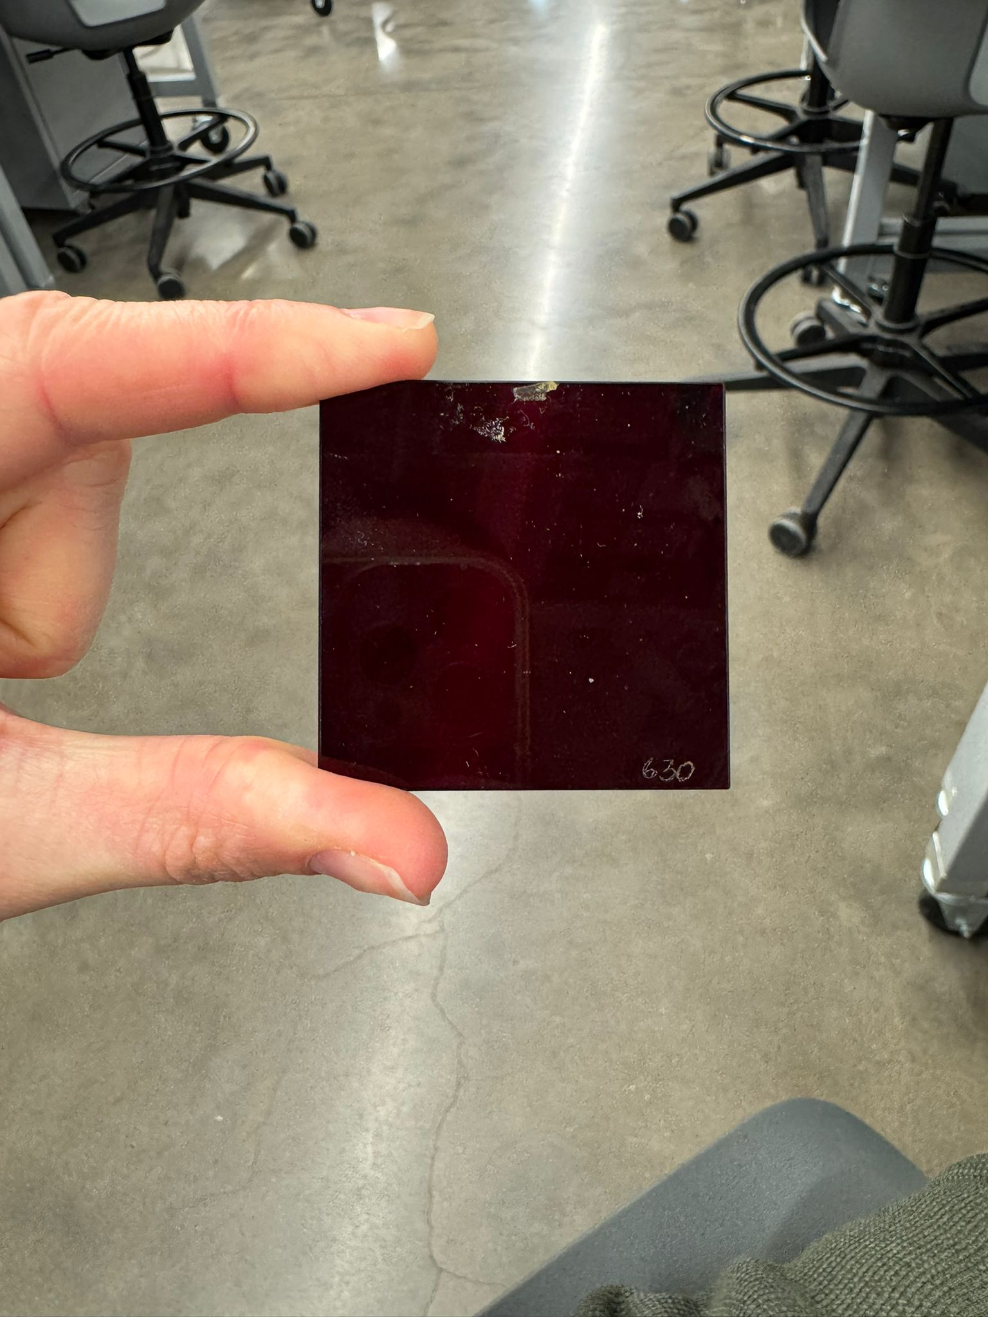
Testing equipment
Wavelength specific colored glass
Halogen bulb - emits IR & entire light spectra

Slide 19
Remaining Tasks
Complete coding for Sensors
Validate and test sensors for demo day
Key Tasks for 404
Integrate with other subsystems
Connect to App
Connect to power supply
Collect data from MPPT and battery system

Slide 20
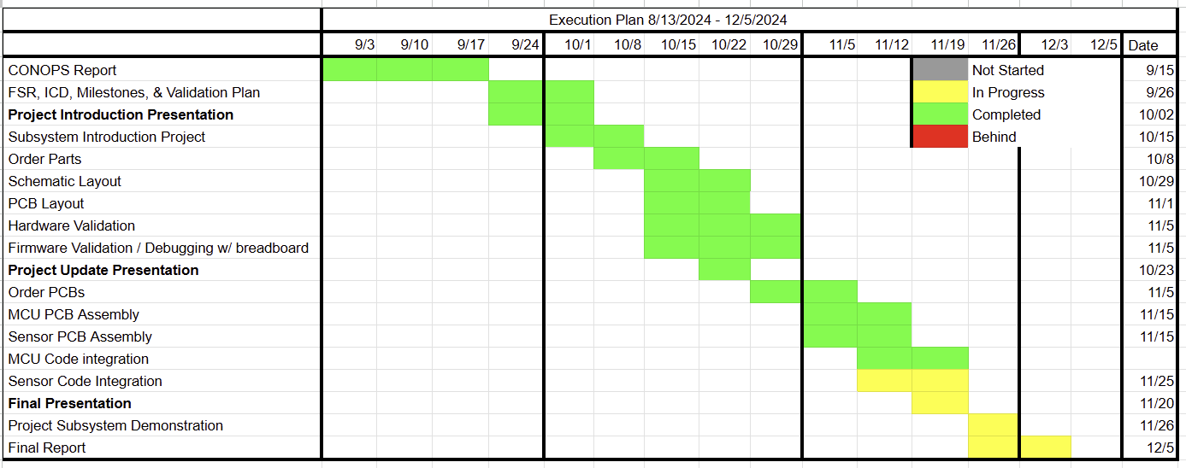
Subsystem Progress

Slide 21
Power Generation System
Team member: Atahan Bakanyildiz
Accomplishments since the last presentation <28> hrs | Ongoing progress/problems and plans until the next presentation
PCB Design Complete PCB and Parts Ordered Solar Panel and Battery tested with off-the-shelf components Components tested with breadboarding | PCB Assembly Validation Final Demo: Solar panel or voltage source in to charge controller Voltage levels monitored on output of charge control (towards battery) Verification of Voltage difference on battery

Slide 22
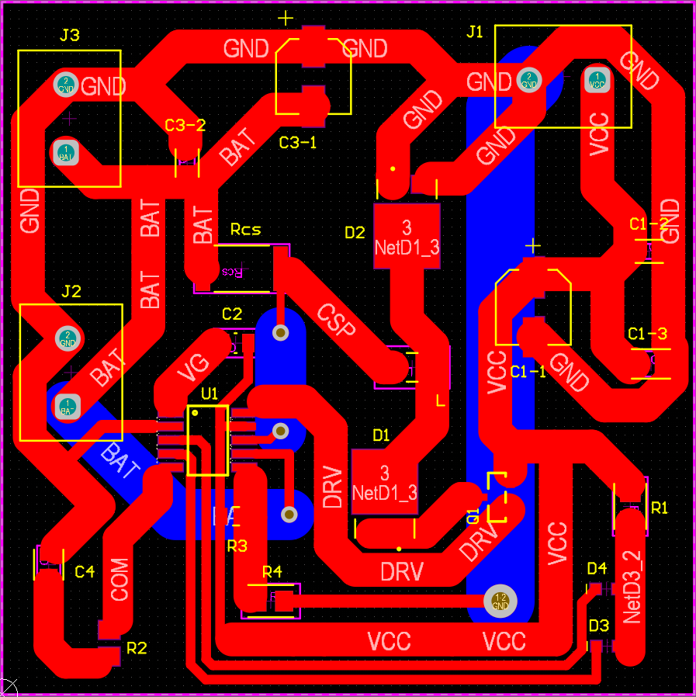
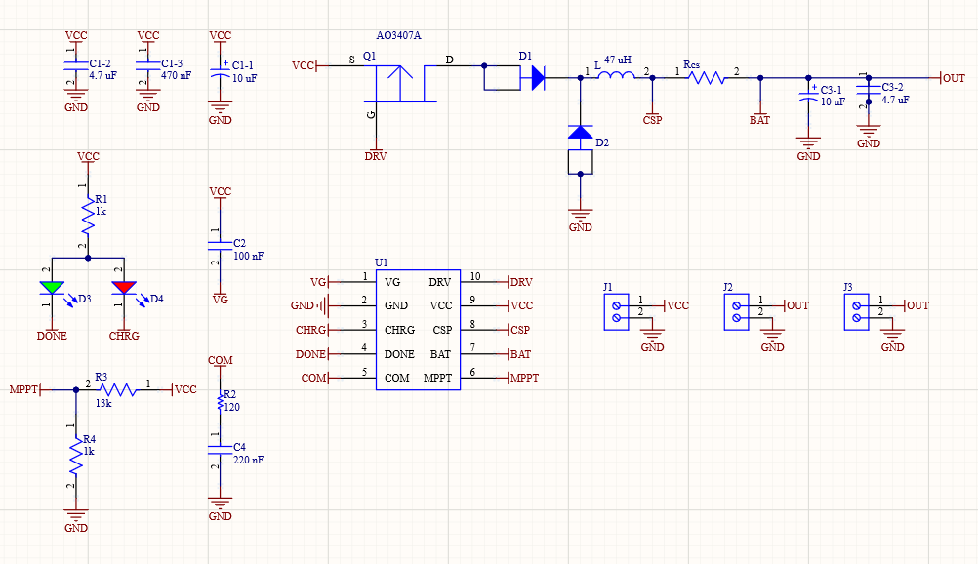
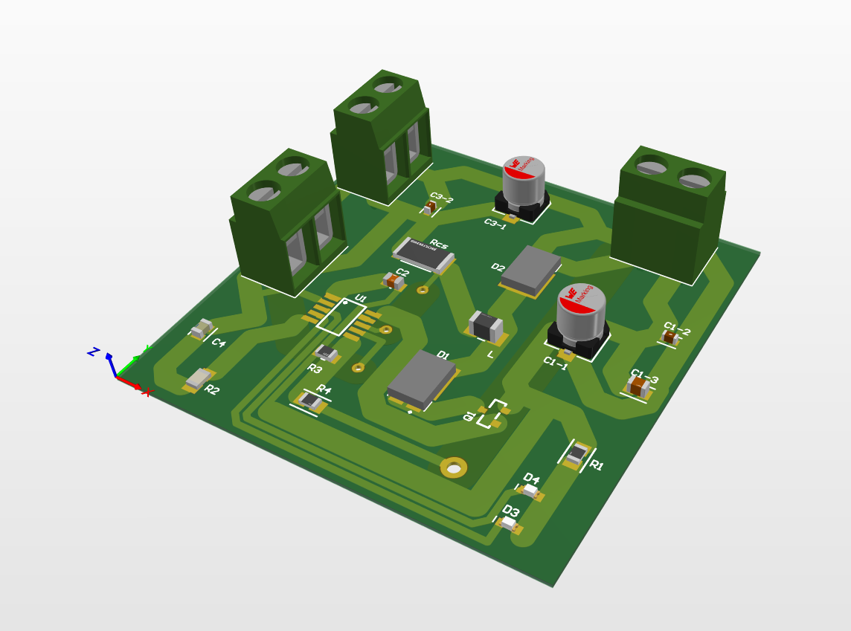
Charge Controller PCB Design

Slide 23
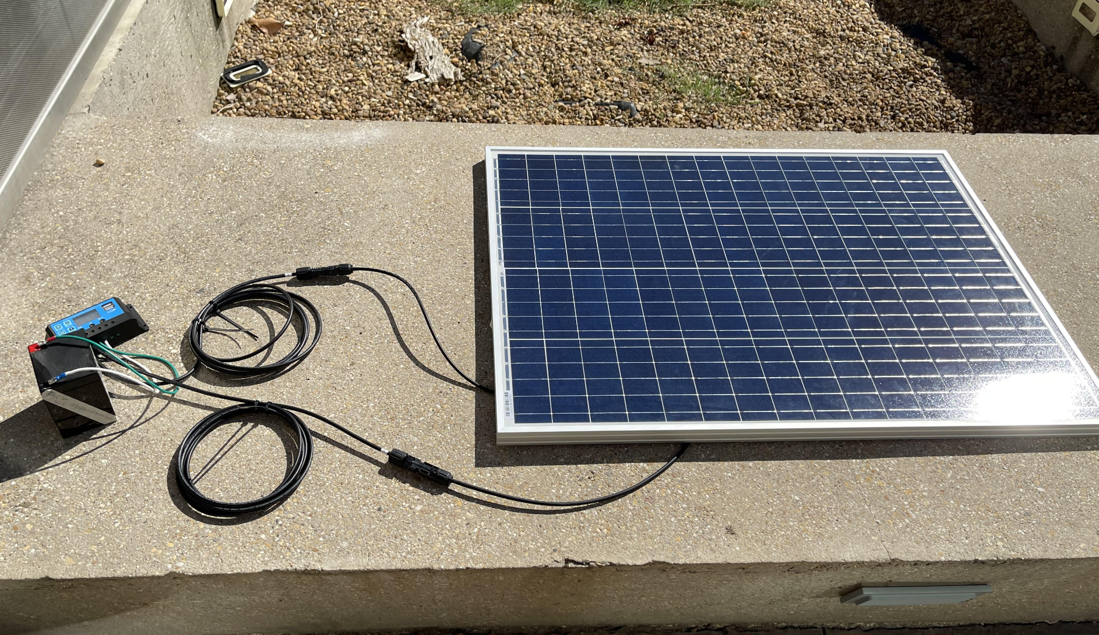
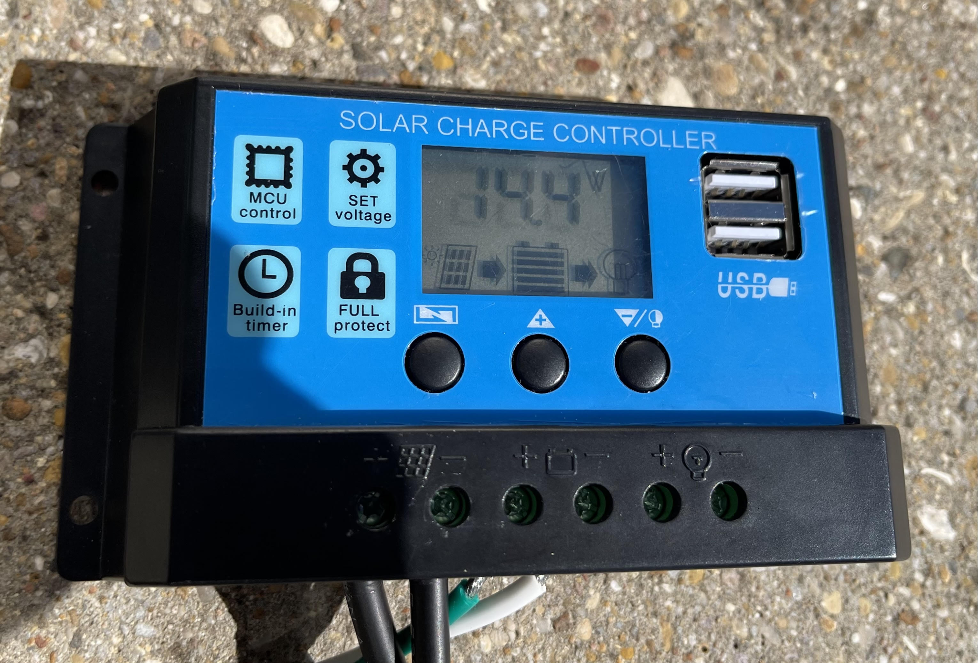
Charge Controller Component Testing
Validation Data
Solar Panel Output Voltage : 18.86V
Charge Controller Output Voltage : 14.047 V
20 Minutes Charge Time Battery Voltage : 12.6V -> 13.1V
79.212W / 100W Theoretical
-> 79.212 % MPPT Efficiency

Slide 24
Remaining Tasks
Finishing PCB Assembly
Video and data documentation of controller with Solar Panel
Key Tasks for 404
Integrate with other subsystems
Create Battery Voltage Tracking / Gas Gauge
Share data from Gauge to MCU subsystem

Slide 25
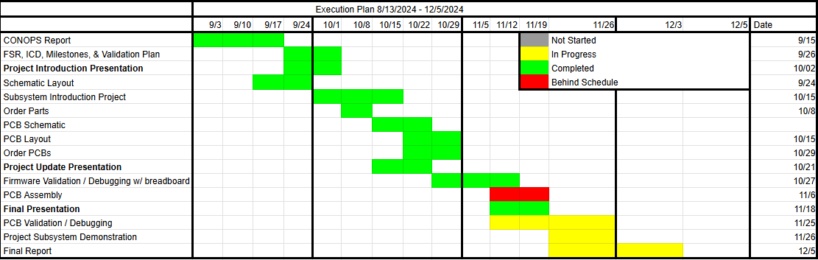
Subsystem Progress

Slide 26
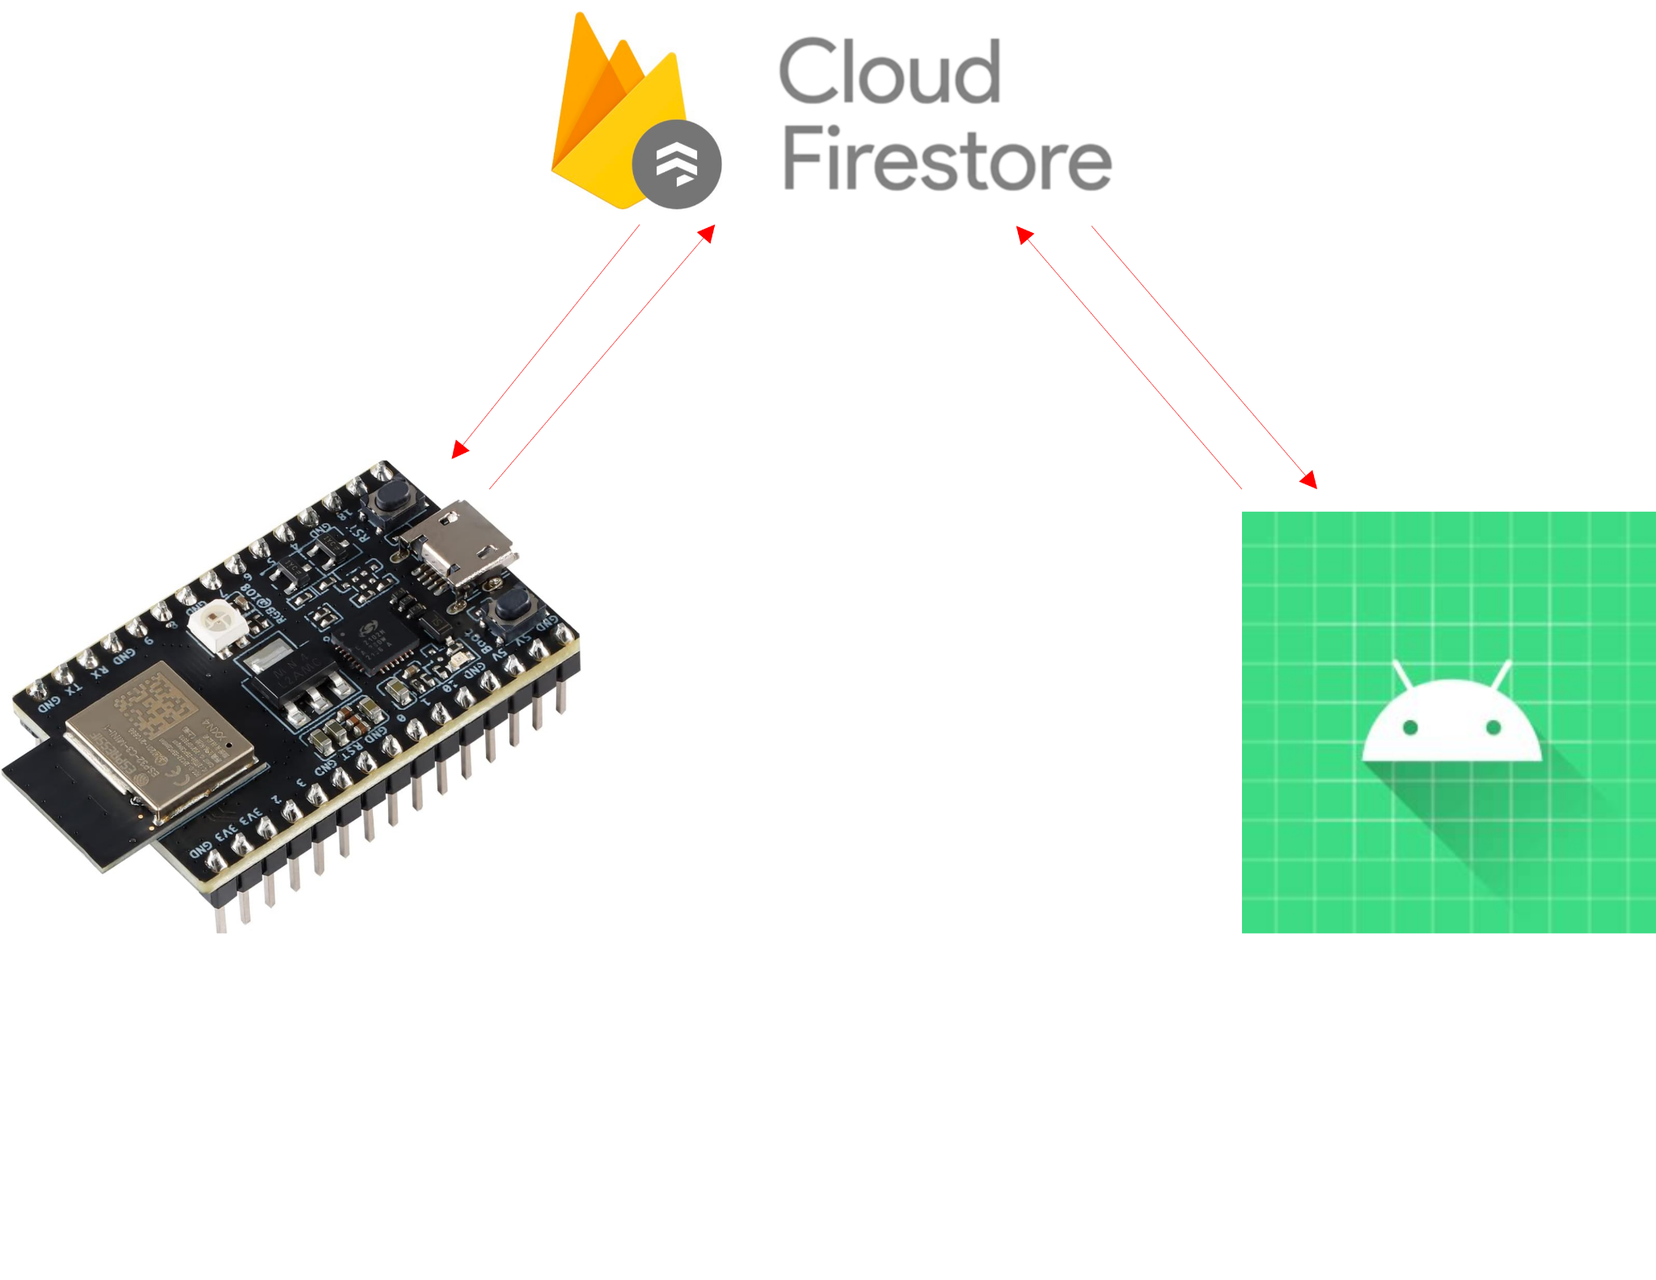
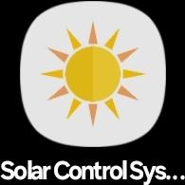
App and Database progress
Accomplishments since last presentation Total time spent: 28 hrs | Ongoing progress, problems and plans until next presentation
Android App and Firebase Cloud Firestore database connected App can display data from the Firebase online database App has login page and ability to differentiate between users UI mostly complete | App still has some crashes switching between fragments; debugging ongoing Database planning for integration with rest of project for 404

Slide 27
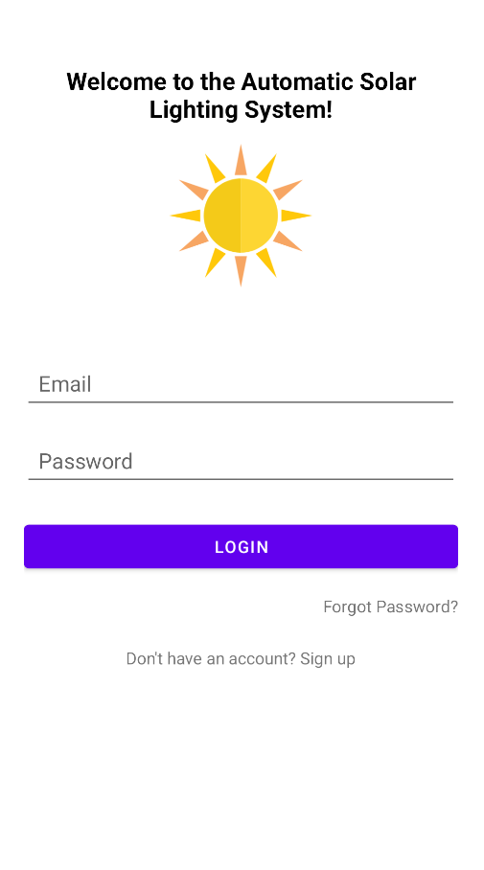
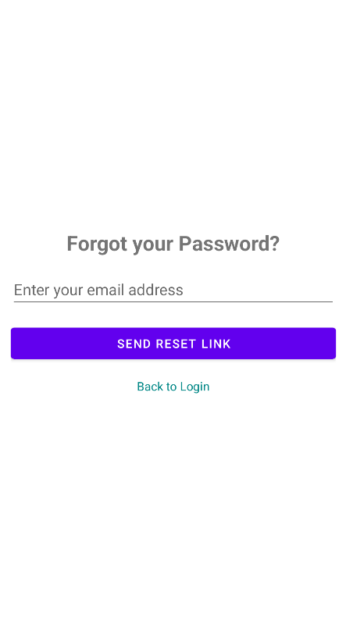
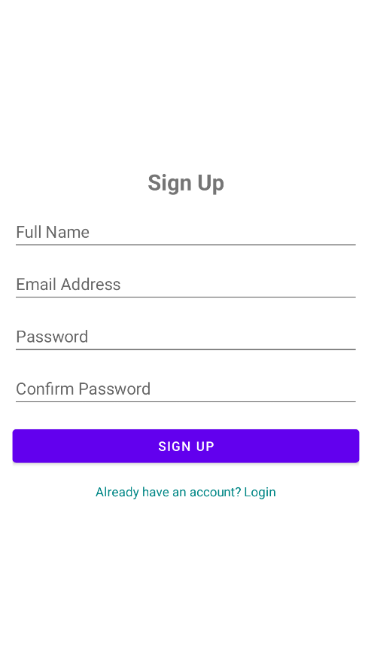
App Login Page

Slide 28
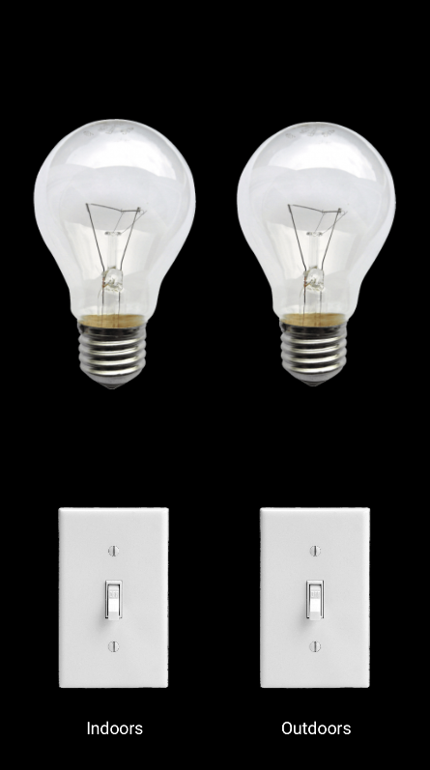
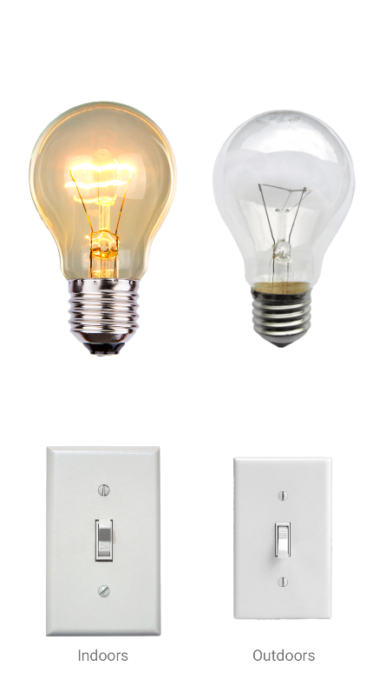
Control Screen

Slide 29
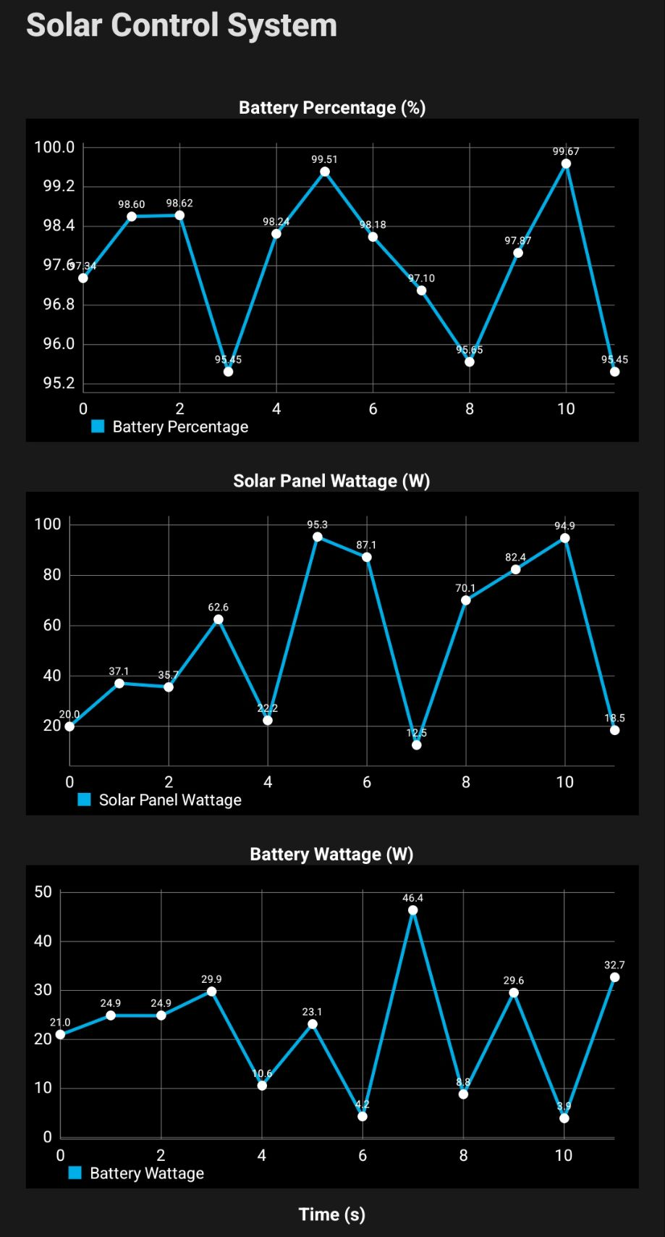
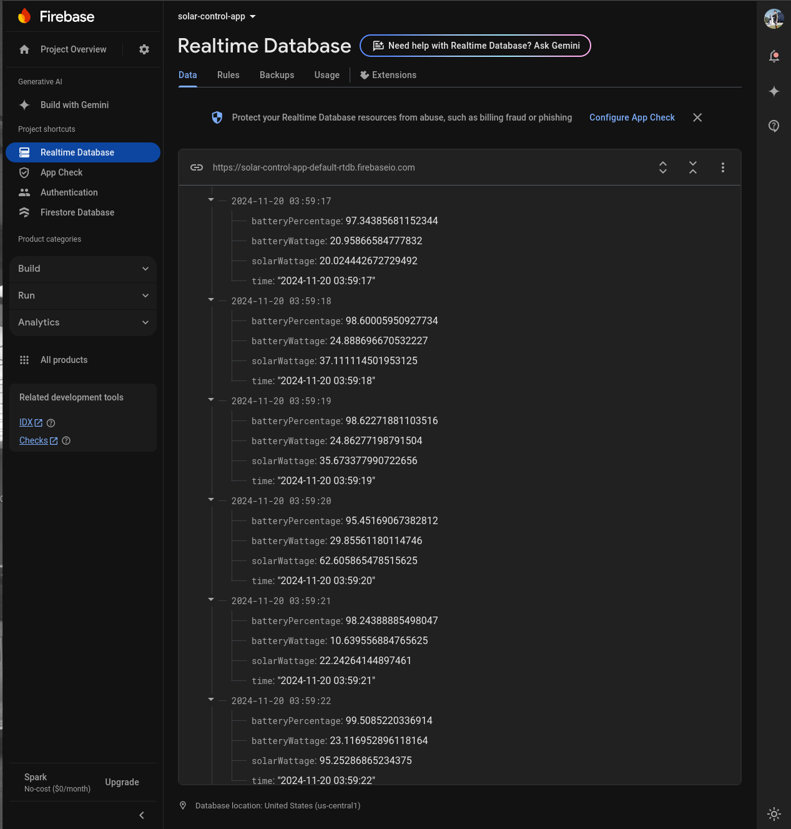
App Displaying Data from Firebase

Slide 30
App & Database Remaining Tasks
403:
Fix app fragment switching bugs
Finish login, forgot password, sign up page backend database
404:
Prepare database for integration with overall system
App may need to be adjusted accordingly

Slide 31
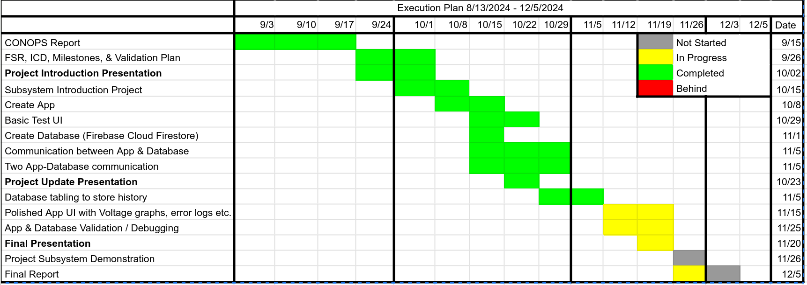
App and Database Subsystem Progress

Slide 32
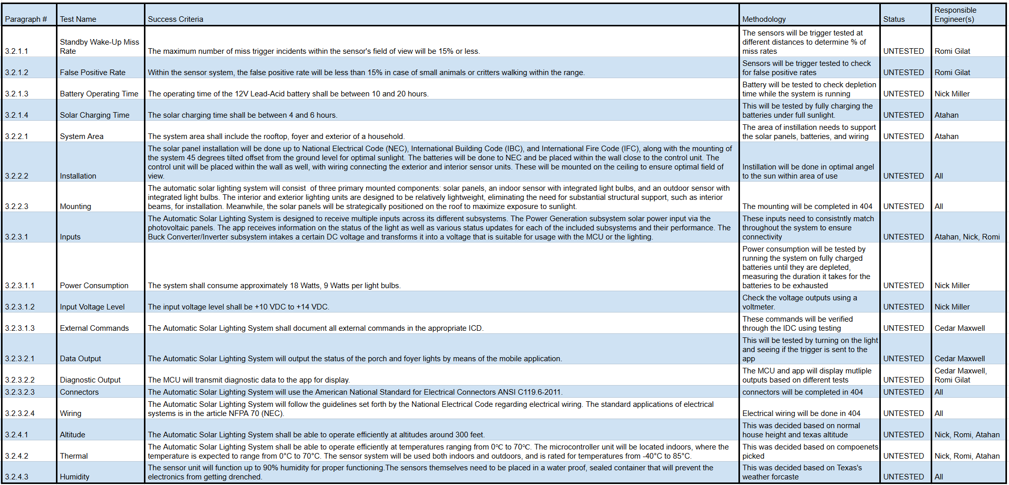
Verification Schedule

